Slide 1
International Conference GOOD PRACTICES IN SKILLS DEVELOPMENT IN THE METAL AND ELECTRO INDUSTRY 4 October 2017 Chamber of Commerce and Industry of Slovenia Dimičeva 13, Ljubljana, Slovenia

Slide 2
CONFERENCE PROGRAMME
9:30 10:00 | Registration of participants
10:00 10:05 | Presentation of the conference programme
10:05 10:15 | Key achievements of the skillME project Janja PETKOVŠEK, Director, CCIS-Metal Processing Industry Association (GZS)
10:15 10:30 | Welcoming address Samo HRIBAR MILIČ, General Manager, Chamber of Commerce and Industry of Slovenia (GZS) Jurij SNOJ, Acting Director, Employment Directorate of the Ministry of Labour (MDDSZ) Urška MARENTIČ, Deputy Director, Institute of the Republic of Slovenia for Vocational Education and Training (CPI)
10:30 10:45 | Metalwork Action Plan (2017) in Slovenia Vlasta STOJAK, Employment Service of Slovenia (ZRSZ)
10:45 11:00 | skillME project results in the context of the reorganization and modernization process in VET in Latvia Laura STRODE, National Centre for Education (VISC)
11:00 11:15 | skillME project results and overview on VET in Croatia Marija ŠUTINA, Croatian Employers’ Association (HUP) Nino BUIĆ, The Agency for Vocational Education and Training and Adult Education (ASOO)

Slide 3
11:15 11:30 | skillME trainings in the context of dual education in Slovak Republic Andrej LASZ, The Association of Electro-technical Industry of the Slovak Republic (ZEP SR)
11:30 12:00 | Coffee Break
12:00 12:50 | Sharing of Good Practices – Piloting (Curricula Implementation) Pilot training: Machine Vision – camera usage for robot control Jakub PERICKA and Radovan PETER, students of Secondary Technical School Stará Turá (STSFV) Competencies for the industry of the future Primož KURENT, School Center Kranj (SCK) Composite materials: New era of usage Klavdija STROPNIK, School Center Kranj (SCK) Pilot training: Reading technical documentation – Electrotechnics Damjan POLJANEC, School Center Kranj (SCK) Translation of professional terminology and texts Meta ARNEŽ, School Center Kranj (SCK)
12:50 13:00 | Summary and conclusion of the conference
13:00 | Conference end

Slide 4
skillME
The Skills in Metal and Electro Industry or skillME project is a three-year collaborative project between vocational education and training (VET) providers, national regulatory partners and representatives of the metal and electro industries of the EU member states Croatia, Latvia, Slovakia and Slovenia, which aims at identifying the most endemic skill gaps in the metal and electro industries and developing curricula to fill those gaps that will be implemented into national VET systems.
Project’s objectives
Updating of skills, new skills for new jobs, raising employability
Quality and efficiency of education and training (adequacy)
Cooperation between different stakeholders
Flexicurity
Matching between skills and labour market needs
Equipping young people better for the job market
Education and training tailored for industrial needs

Slide 5
approach, results, achievements
First, project partners identified four most pressing skill gaps among students and workers in the metal and electro industry of the participating countries, which are: READING TECHNICAL DOCUMENTATION, CAD/CAM SYSTEMS, MACHINE VISION, and COMPOSITE MATERIALS.
Next, partners designed curricula and training materials to fill these gaps.
Last,over the past months, partners have been implementing pilot trainings for students and separately for workers of metal and electro companies in all of the project countries, i.e. Croatia, Latvia, Slovakia and Slovenia.
Curricula were designed in line with EQAVET, ECVET and EQF principles; prepared in a fashion to be readily implemented in different (country specific) national frameworks
Significant impact on stakeholders‘ collaboration (understanding, info flow, labour market needs,..)
CEEMET, industriAll
Sectoral social dialogue committe
CEDEFOP
EP
Dinner debate with MPs
European Skills Week
more than 220 students (planned 120)
more than 230 empl (planned 120)
more than 50 companies (planned 30)

Slide 6
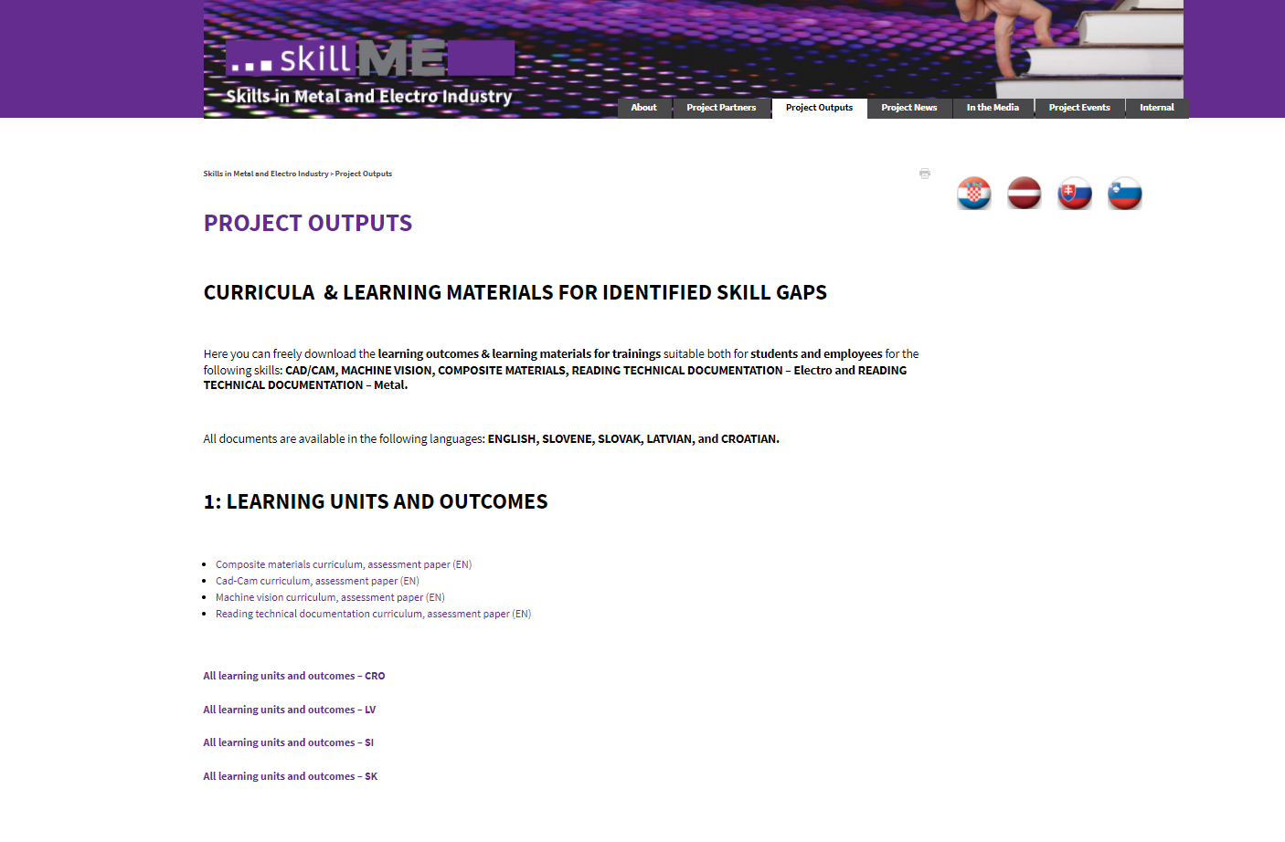
skillME TRAINING MATERIALS CAD/CAM, MACHINE VISION, READING TECHNICAL DOCUMENTATION, COMPOSITE MATERIALS
skillME WEBSITE >> PROJECT OUTPUTS
www.gzs.si/skill-me/vsebina/Project-Outputs

Slide 7
skillME team SLOVENIA
CCIS-Metal Processing Association (represented by Janja Petkovšek, mngm., diss.)
Institute of the Republic of Slovenia for vocational education and training (represented by Davorin Majkus, dsgn.)
School Centre Celje (represented by Denis Kač)

Slide 8
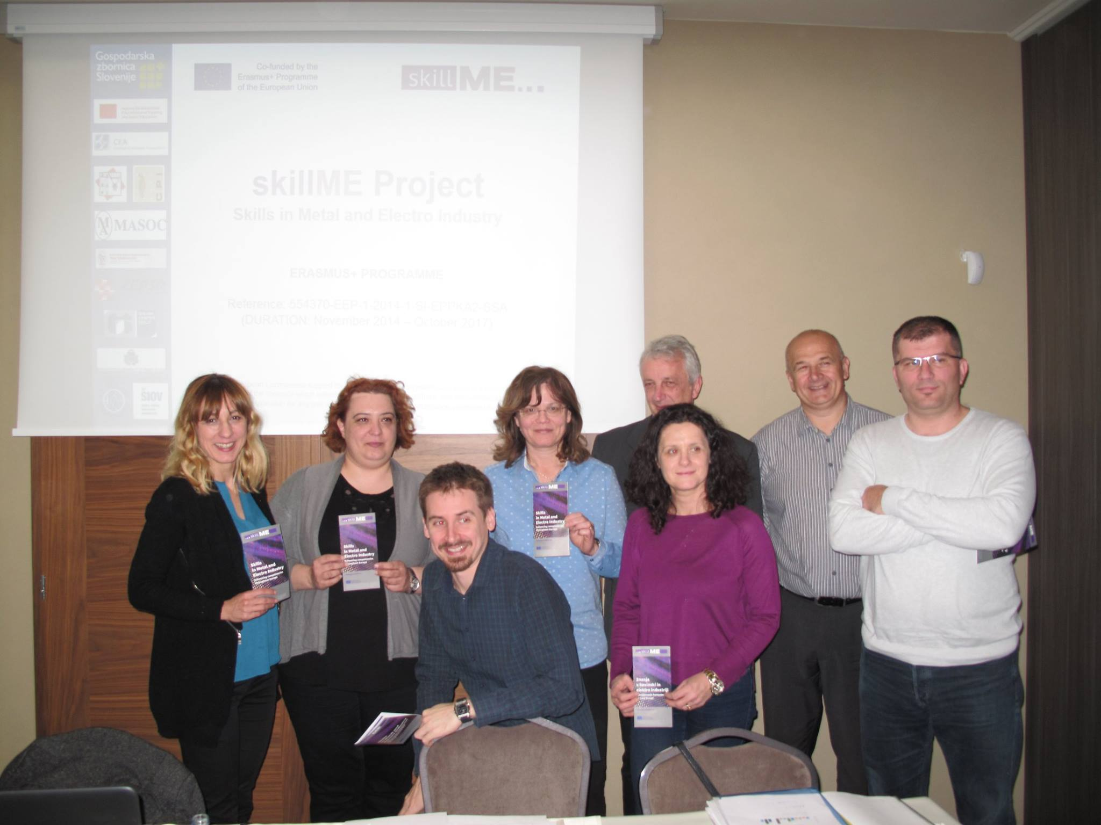
skillME team CROATIA
HUP - Croatian Employers’ Association (represented by Marija Šutina)
AVETAE - Agency for Vocational Education and Training and Adult Education (represented by Nino Buić, QA)
Faust Vrančič Technical school (represented by Dubravko Diklić)

Slide 9
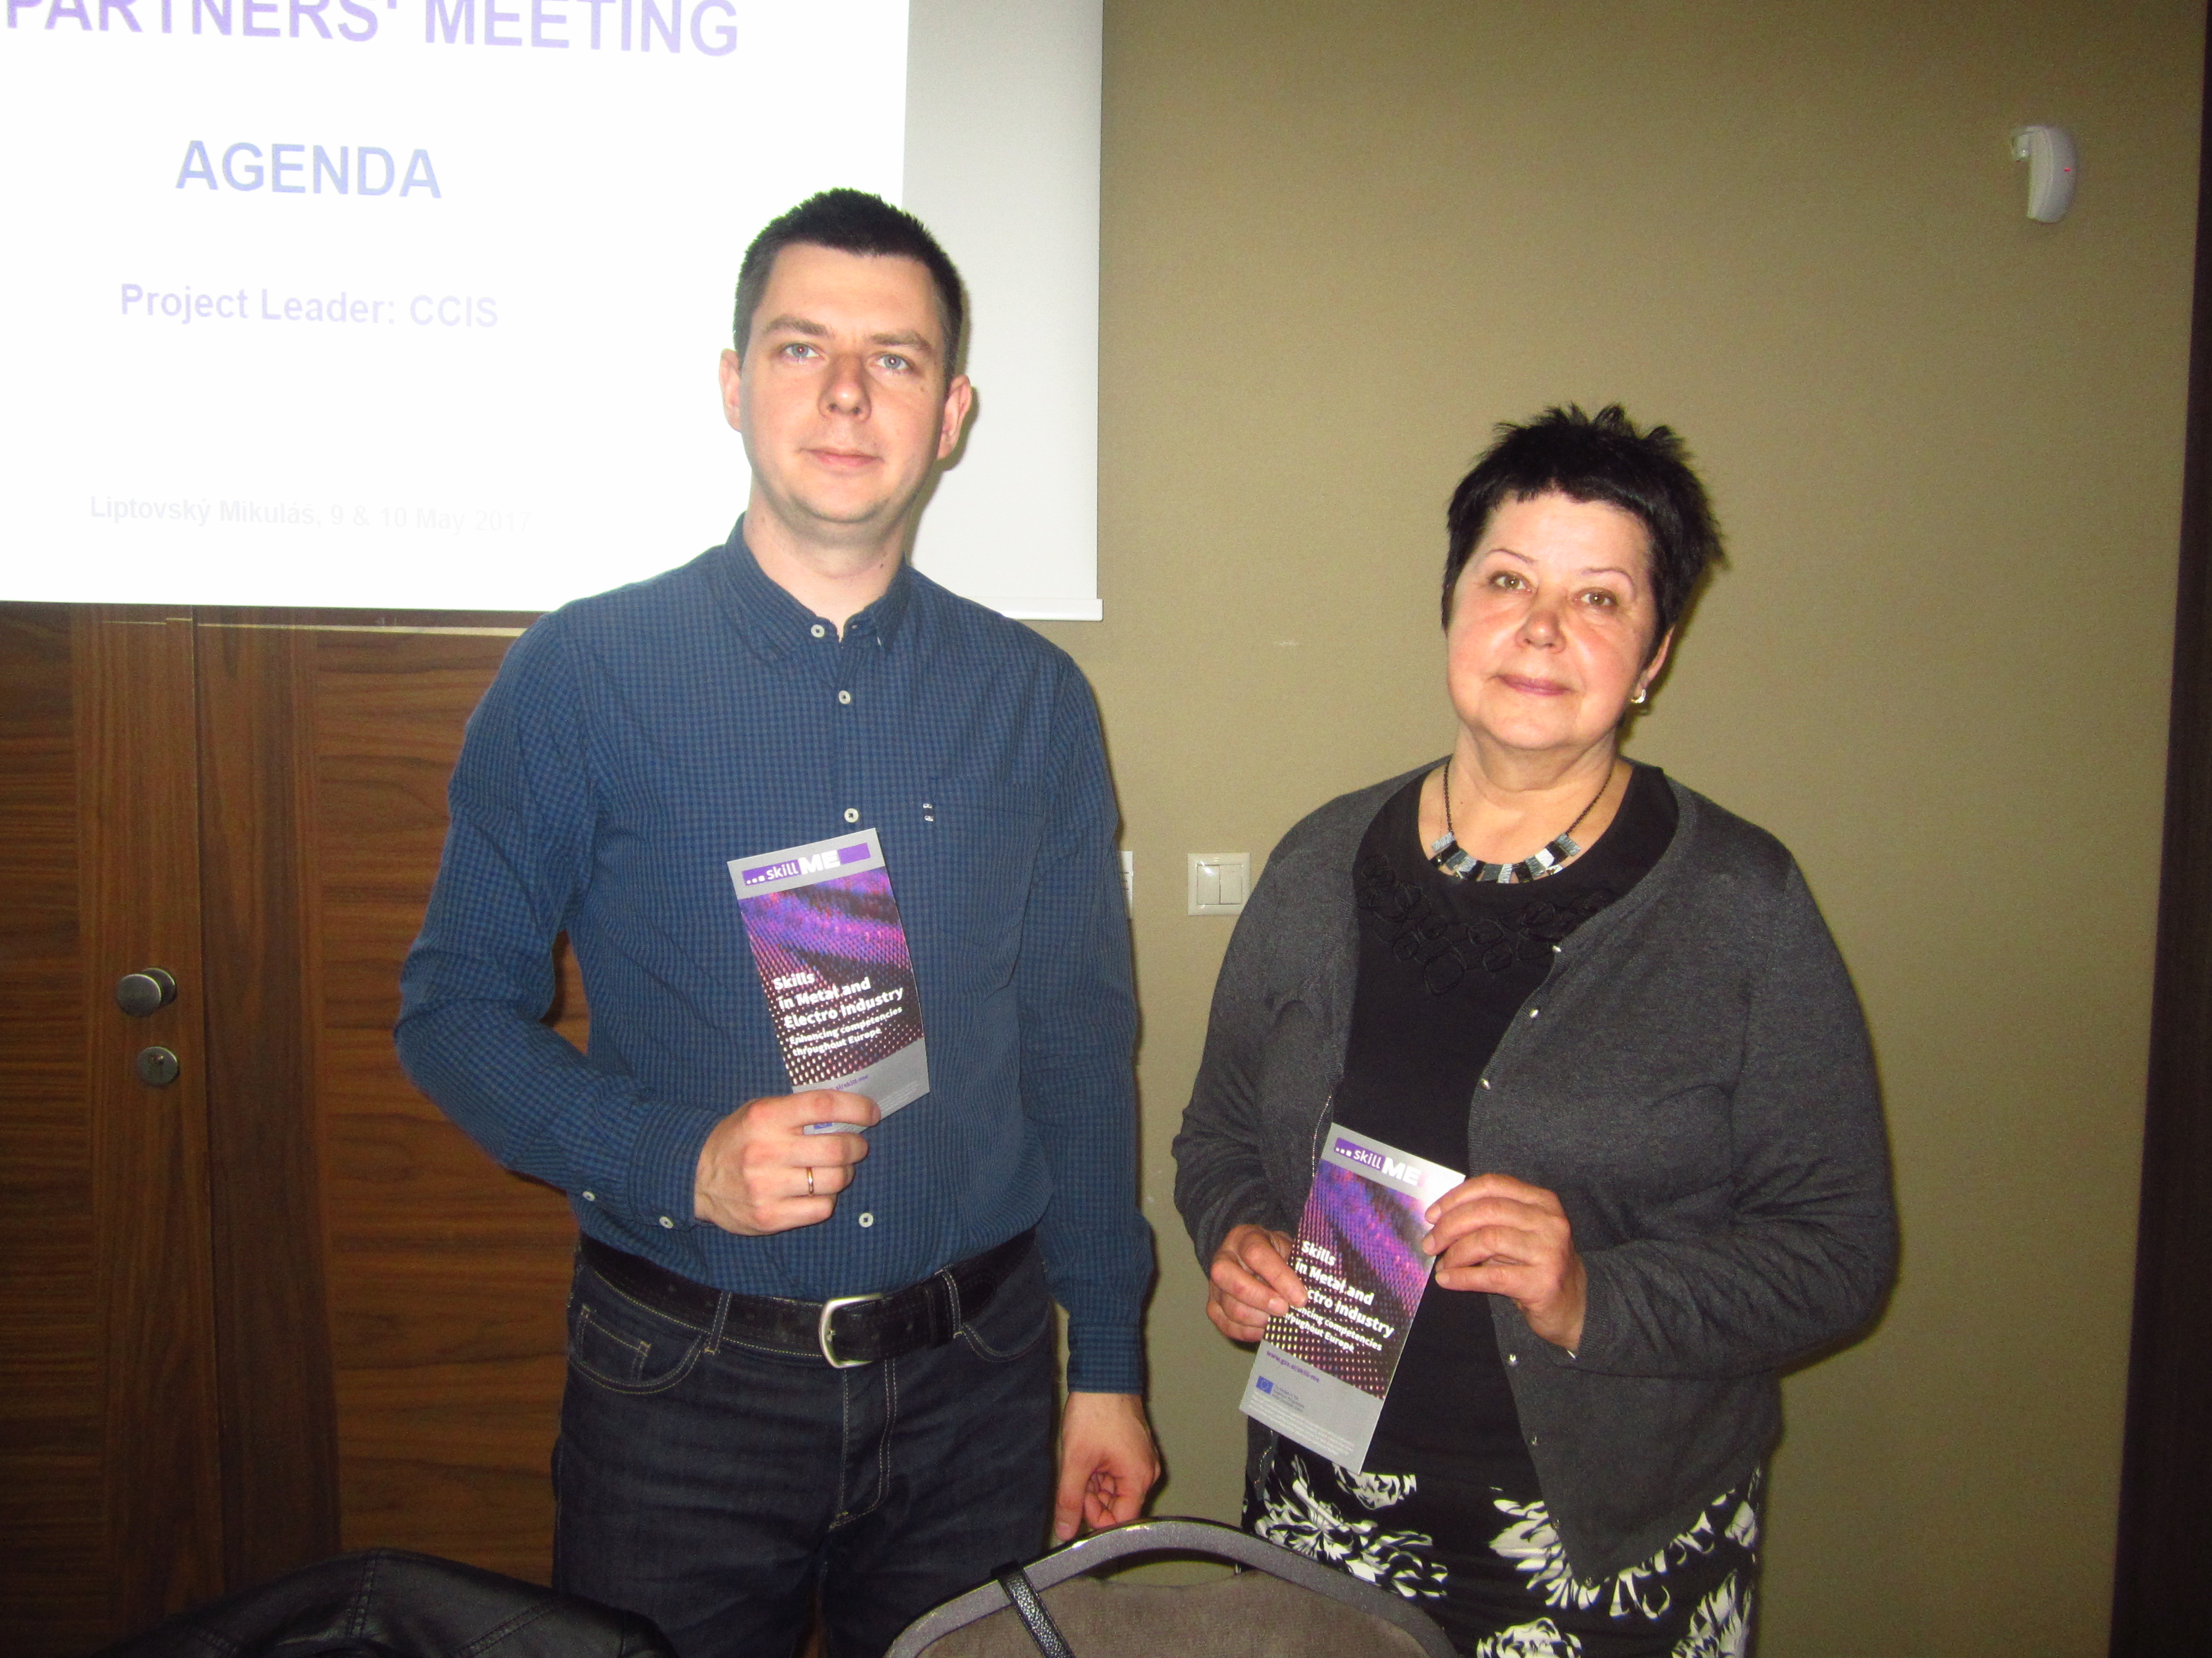
skillME team LATVIA
MASOC - Association of Mechanical engineering and metalworking industries of Latvia (represented by Andris Sekacis, gaps)
VISC - National Centre for Education (represented by Laura Strode)
Vocational Education Competence Centre “Riga Technical College” (represented by Anda Kazusa, piloting)

Slide 10
skillME team SLOVAKIA
ZEP-The Association of Electrotechnical Industry of the Slovak Republic (represented by Andrej Lasz, eval.)
SIOV- Štátny inštitút odborného vzdelávania (represented by Lucia Ilkova)
SPSEST- Secondary Technical School, Stará Turá (represented by Klaudia Urbanova)

Slide 11
..thank you

